Slide 1
Our First NP-Complete Problem
C
B
A
The Cook-Levin theorem

Slide 2
Introduction

Objectives:
  To present the first NP-Complete problem
Overview:
  SAT - definition and examples
  The Cook-Levin theorem
  What next?

Slide 3

SAT
Instance: A Boolean formula.
Problem: To decide if the formula is satisfiable.
A satisfiable Boolean formula:
F
T
T
F
T
T
An unsatisfiable Boolean formula:

Slide 4
To Which Time Complexity Class Does SAT Clearly Belong?
SAT
NP
Co-NP
P

Slide 5

SAT is in NP:
Non-Deterministic Algorithm
Guess an assignment to the variables.
Check the assignment.
F
T
T
F
T
T
x₁
F
✓
x₂
T
x₃
T

Slide 6
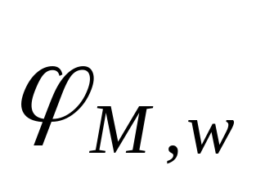

The Cook-Levin Theorem: SAT is NP-Complete
SIP 254-259
Proof Idea: For any NP machine M and any input string w, we construct a Boolean formula ϕ_{M,w} which is satisfiable iff M accepts w.
...
...

Slide 7
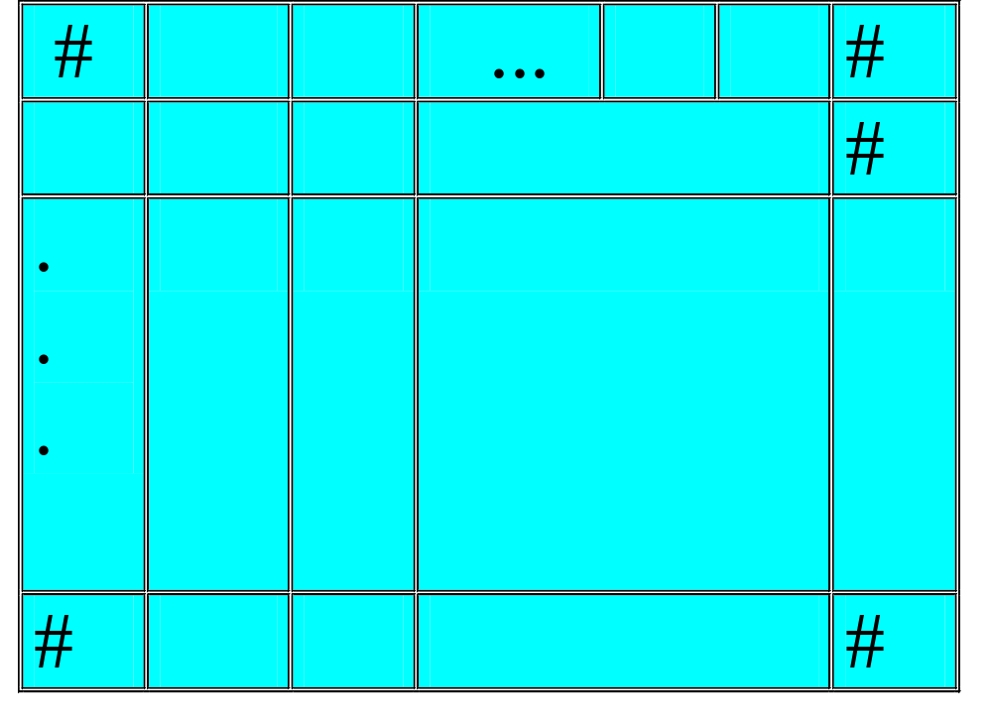
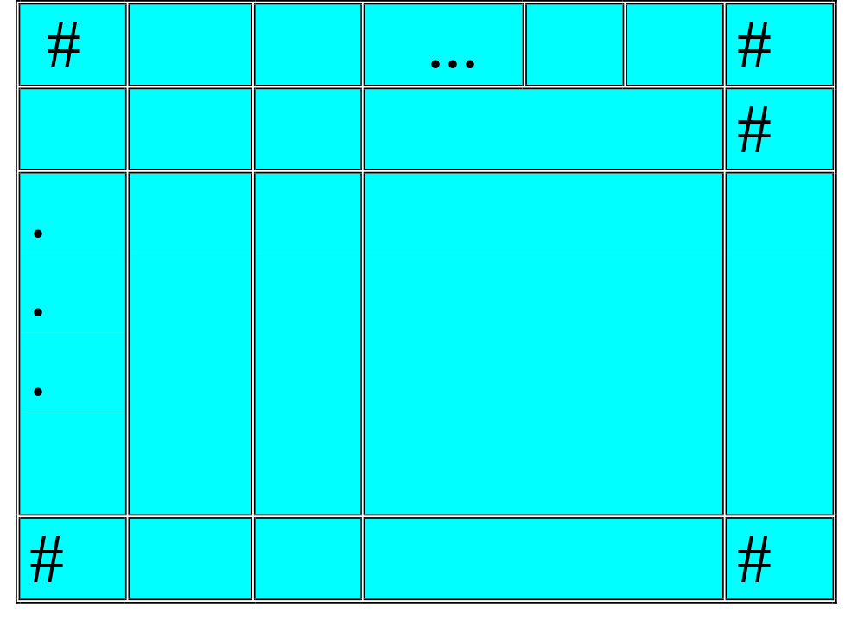
Representing a Computation by a Configurations Table
n^{k}
_
_
q₀
_
q₀
q₀
w₁
w₁
w₁
w_{n}
w_{n}
w_{n}
upper bound on
the running time
the content of the (relevant part of the) tape
and the position of the head
n^{k}
indicates tape bounds

Slide 8
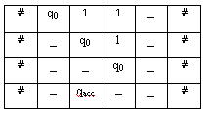
Tableau: Example
TM:
  Q={q₀,q_{accept},q_{reject}}
  Σ={1}
  Γ={1,_}
  δ(q₀,1)={(q₀,_,R)}
  δ(q₀,_)={(q_{accept},L)}
tableau (input 11)
Q: what does this
machine compute?

Slide 9
The Variables of the Formula
stands for: “Is s the content of cell (i,j)?”
x_{i, j, s}
symbol (s∈Γ∪Q∪{#})
position in the tableau (1≤i,j≤n^{k})

Slide 10
The Formula ϕ
ϕ_{M,w} = φ_{cell} ∧ φ_{start} ∧ φ_{move} ∧ φ_{accept}
cell content consistency
machine accepts
input consistency
transition legal

Slide 11
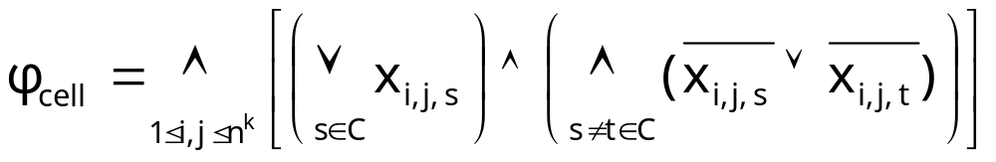
Ensuring Unique Cell Content
The (i,j) cell must contain some symbol
It shouldn’t contain different symbols.
!
Note: the length of this formula is polynomial in n.

Slide 12
Ensuring Initial Configuration Corresponds to Input
Observe: we can explicitly state the desired configuration in the first step. Assuming the input string is w₁w₂...w_{n},

Slide 13

Ensuring the Computation Accepts
The accepting state is visited during the computation.

Slide 14
Ensuring Every Transition is Legal
Local: only need
to examine
2×3 “windows”

Slide 15






Which Windows are Legal in the Following Example?
TM:
  Q={q₀,q_{accept},q_{reject}}
  Σ={1}
  Γ={1,_}
  δ(q₀,1)={(q₀,_,R)}
  δ(q₀,_)={(q_{accept},L)}
✗
✓
✓
✓
✗
✓

Slide 16
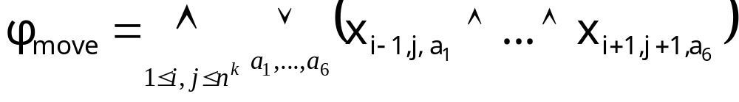
Ensuring Every Transition is Legal
for any a₁,...,a₆ s.t. this is a legal window
a₁
a₂
a₃
a₄
a₅
a₆

Slide 17
The Bottom Line
ϕ_{M,w} = φ_{cell} ∧ φ_{start} ∧ φ_{move} ∧ φ_{accept}
ϕ, which is of size polynomial in n - Check! - is satisfiable iff the TM accepts the input string.

Slide 18
Conclusion: SAT is NP-Complete
For any language A in NP,
testing
membership in A
satisfiability
problem
can be reduced to...

Slide 19
Revisiting the Map
SAT
NP
Co-NP
NPC
P

Slide 20
Looking Forward
From now on, in order to show some NP problem is NP-Complete, we merely need to reduce SAT to it.
any NP
problem
can be reduced to...
SAT
can be reduced to...
We’ve already shown this
new NP
problem
will imply the new problem is in NPC

Slide 21
... and Beyond!
Moreover, every NP-Complete problem we discover, provides us with a new way for showing problems to be NP-Complete.
any NP
problem
can be reduced to...
Known
NP-hard
problem
can be reduced to...
new NP
problem

Slide 22
Summary
We’ve proved SAT is NP-Complete.
We’ve also described a general method for showing other problems are NP-Complete too.
◉

